Slide 1
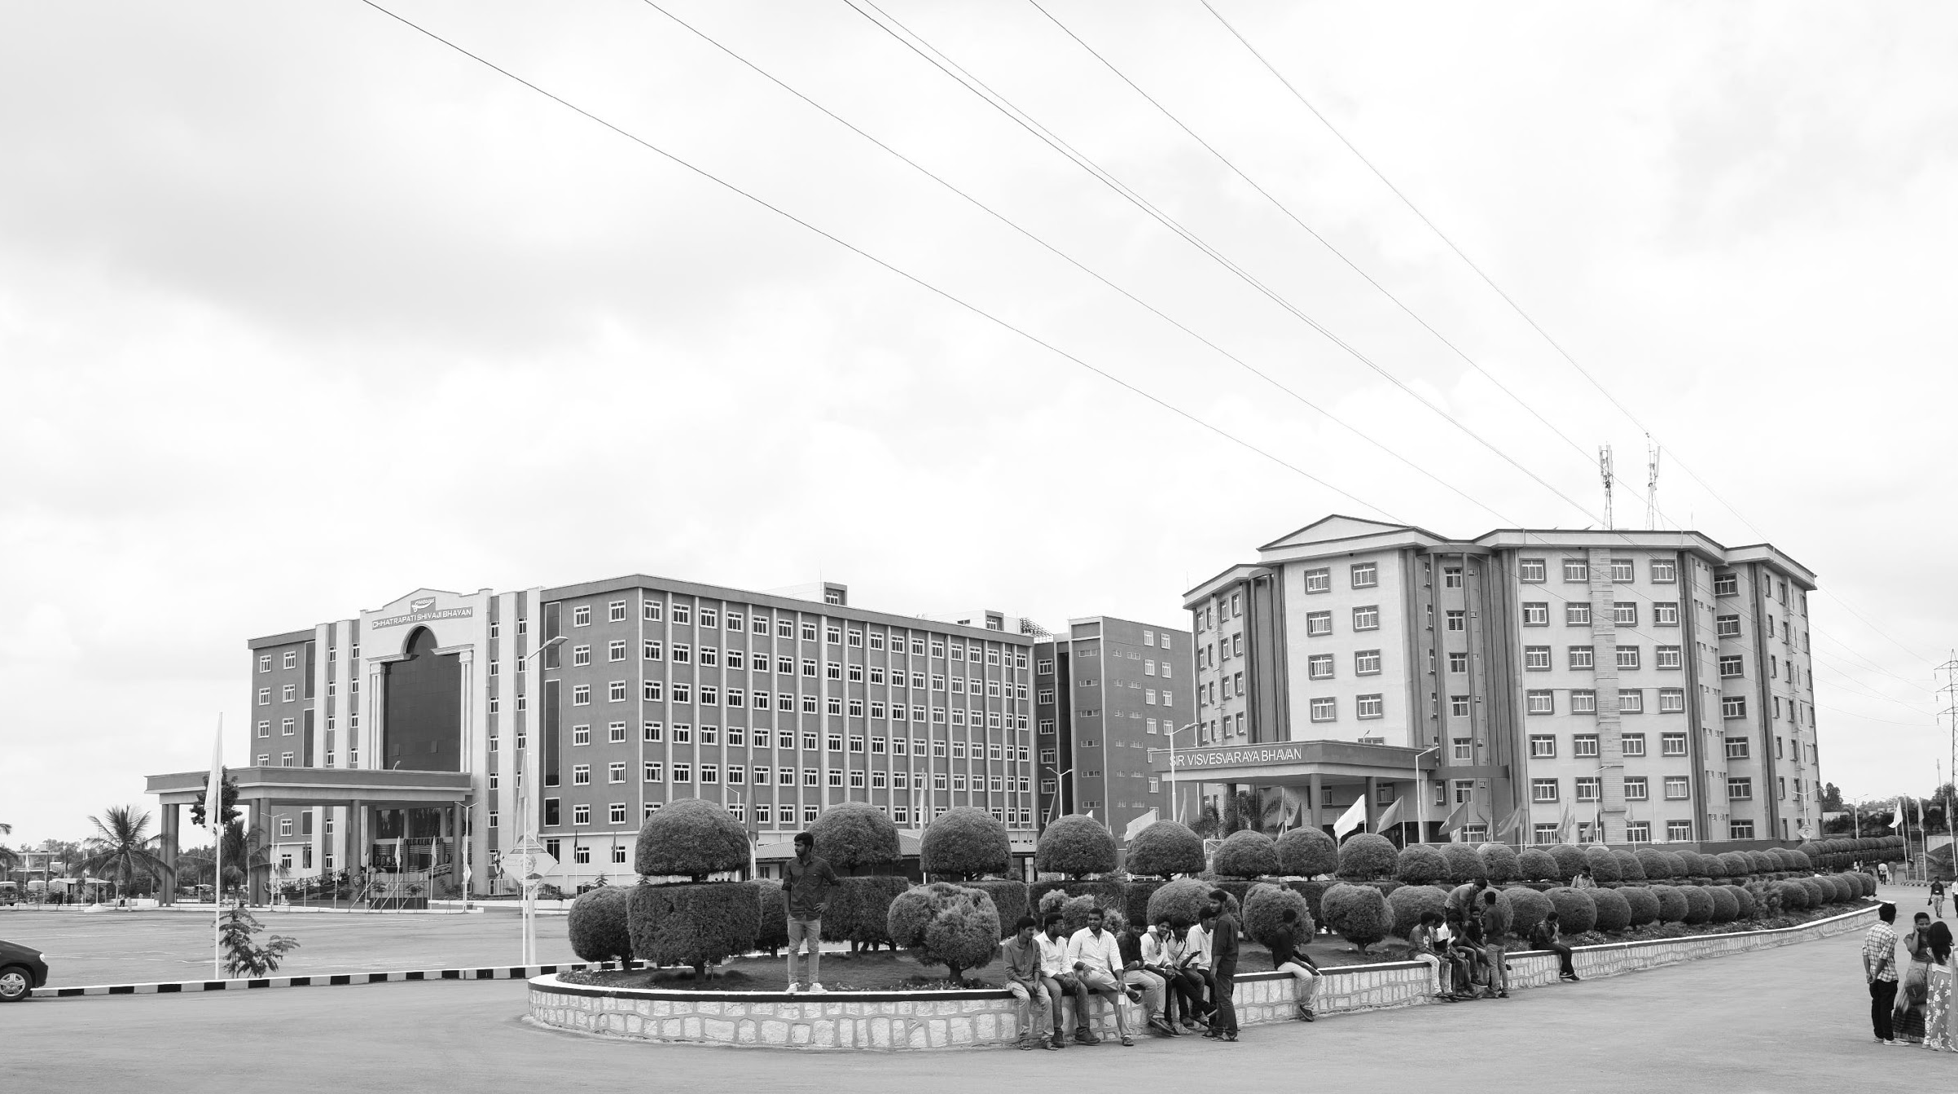

A Dielectrically Modulated GaN/AlN/HfAlOx MOSHEMT with a Nanogap Embedded Cavity for Biosensing Applications
Mid-Review 3
Major Project
Project ID: V12
AY 2021-25
GITAM (Deemed-to-be) University
Project Team:
Piyush Kumar
Athukuri V S Sai Jayanth
R Hima Bindu
Department of Electrical Electronics and Communication Engineering
Project Mentor:
Mr. Girish Shankar Mishra
Project Incharge:
Dr. Pankaj Kandhway
www.gitam.edu

Slide 2
Objective and Goals
Objective
Brief Description: The GaN/AlGaN material system displays excellent sensitivity, compatibility with living organisms, stability in various chemical environments, and rapid response times. Biosensor employs modulation of two-dimensional electron gas (2DEG) at heterojunction to accurately detect surface charge. The key innovation is that Al₂O₃ passivation enhances surface uniformity, reduces defect density, and enhances device stability.
Goals
Main Goals
Early Detection of Pathogens
High Sensitivity and Accuracy
Surface Charge Detection
Additional Goals
Miniaturization and Quick Response
Improved Chemical Stability
Multi-functional Biosensor Development

Slide 3
Project Plan
Phase | Timeline | Activities
Project Planning | Week 1 - Week 2 | Conducting literature review, defining project objectives, and developing a research framework.
Material Selection | Week 3 - Week 4 | Selecting III-V materials (e.g., GaN/AlN/HfAlOx) and passivation layers (e.g., Al₂O₃) for enhanced sensitivity.
Heterostructure Design | Week 5 - Week 7 | Designing and simulating the GaN/AlN/HfAlOx MOS-HEMT structure with nanogap cavity for optimal biomolecule interaction.
Fabrication and Functionalization | Week 8 - Week 10 | Fabricating the MOS-HEMT structure, integrating the nanogap cavity, and functionalizing the surface for biomolecule adhesion.
Performance Analysis | Week 11 - Week 13 | Evaluating sensitivity by testing electrical parameters (e.g., threshold voltage shifts, drain current variation).
Optimization | Week 14 - Week 15 | Refining layer thickness, nanogap dimensions, and cavity fill height to maximize device sensitivity and stability.
Report Writing | Week 16 - Week 18 | Documenting experimental results, performance metrics, and project findings for final reporting.

Slide 4
Literature Survey (Improved post minor project)
Key Publications
1). Performance evaluation of electrical properties of GaN MOS-HEMTs based biosensors for rapid detection of viruses
Authors: Aasif Mohammad Bhat, Arathy Varghese, Nawaz Shafi, C. Periasamy
Journal: IEEE Transactions
Key Insights: The study presents a highly sensitive GaN/AlN/AlGaN MOSHEMT biosensor capable of detecting neutral and charged biomolecules through shifts in threshold voltage and drain current.
2). A Complete Analytical Model for MOS-HEMT Biosensors: Capturing the Effect of Stern Layer and Charge Screening on Sensor Performance
Authors: Arathy Varghese, Pallabi Das, Siddharth Tallur
Journal: IEEE Transactions
Key Insights: The study introduces an analytical model for MOS-HEMT biosensors, incorporating Stern layer and charge screening effects, improving accuracy in detecting biomarkers like prostate-specific antigen
3).Impact of InGaN Notch on Sensitivity in Dielectric Modulated Dual Channel GaN MOSHEMT for Label-Free Biosensing
Authors: Girish Shankar Mishra, N. Mohankumar, Sankalp Kumar Singh
Journal: IEEE Transactions
Key Insights: Enhanced sensitivity (up to 74%) through InGaN notch in GaN MOSHEMTs, offering scalable and precise biosensing applications.

Slide 5
Literature Survey (Improved post minor project)
Key Publications
4).A Dielectrically Modulated GaN/AlN/AlGaN MOSHEMT with a Nanogap Embedded Cavity for Biosensing Applications
Authors: Faiza Mouffoki, Driss Bouguenna, Fatima Zohra Dahou, Abbès Beloufa, Sajad Ahmad Loan
Journal: Materials Today Communications
Key Insights: The study proposes and simulates AlGaN/AlN/GaN MOS-HEMT biosensors with a cavity for ultrasensitive virus detection, achieving high sensitivity through the dielectric constant modulation of viruses.
5). Influence of back barrier layer thickness on device performance of AlGaN/GaN MOS-HEMT
Authors: Aboo Bakar Khan, Mohini Sharma, Syed Gulraze Anjum, Mohd Jawaid Siddiqui
Journal: Advanced Materials Proceedings, 2018, Volume 3
Key Insights: The study investigates the impact of varying back barrier layer thickness in AlGaN/GaN MOS-HEMT devices, revealing improvements in electron confinement and high-frequency performance, making them promising for analog and RF applications.

Slide 6
Literature Survey (Improved post minor project)
Key Resources –
Whitepaper
GaN MOS-HEMT devices feature cavity-based designs for ultrasensitive biosensing, enabling high sensitivity for virus and biomolecule detection.
Application Notes
Optimized back barrier thickness enhances electron confinement and performance, making these devices ideal for biomedical diagnostics and RF communication systems.
Virus detection, RF amplifiers, and biomedical diagnostics.
Datasheet
High electron mobility (2DEG technology) for superior performance in biosensing and RF applications.
Advanced cavity-based design for ultrasensitive virus detection with a sensitivity improvement of up to 62% (e.g., SARS-CoV-2 detection).
Existing Implementations –
Products
Nano TCAD ViDES: For simulating nanoscale devices, including MOS-based transistors.
Opensource
BioFET-SIM: An open-source simulation tool for modeling biosensors like ISFETs, which can be extended to MOS-HEMTs.
GitHub
Ngspice: Open-source SPICE simulator for electronic circuit design, compatible with MOS-HEMT-based circuits.

Slide 7
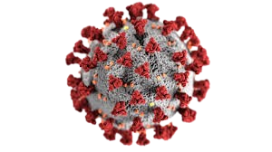
Architecture
Structural Diagram
L_{cavity} =0.15 μm
L_{oxide}=0.15 μm
Gold – Gate
L_{S} = 1μm
SiO2
(0.013µm)
HfAlOx (0.002µm)
Source
0.029(µm)
AlGaN -- barrier(0.025µm)
Drain 0.029(µm)
AlN -- Spacer(0.002µm)
GaN -- Channel(2µm)
AlN – Nucleation(0.03µm)
SiC -- Substrate(2µm)
10µm

Slide 8
MOSHEMT Structure
The structure in the diagram represents a Gallium Nitride (GaN)-based High Electron Mobility Transistor (HEMT). This type of transistor is widely used in high-frequency, high-power, and high-efficiency applications such as RF (radio frequency) power amplifiers, radar systems, satellite communications, and power electronics.
Material Composition
SiC Substrate:
Silicon Carbide (SiC) is used as the base material due to its high thermal conductivity and mechanical stability.
Provides excellent heat dissipation, which is critical for high-power applications.
GaN Channel:
The core semiconductor layer where electron transport occurs.
Provides high electron mobility, enabling fast switching and high-frequency operation.

Slide 9
AlGaN Barrier & AlN Spacer:
The AlGaN barrier layer induces a 2D Electron Gas (2DEG) at the GaN/AlGaN interface, which acts as the primary conduction channel.
The AlN spacer improves electron mobility by reducing scattering.
Source, Drain, and Gate:
Source and Drain: These are the electrodes where electrons enter and exit the channel.
Gate: Controls the flow of electrons in the channel. The gold gate improves conductivity.
HfAlOx and SiO2 Layers:
HfAlOx: A high-k dielectric layer that improves gate insulation and reduces leakage currents.
SiO2: Used for passivation and insulation, protecting the device from environmental degradation.
Dimensions & Layout:
The structure includes specific spacing for source-to-gate (L_S = 1µm) and gate length (L_G = 0.05µm) to optimize performance.
The total width of 10µm ensures efficient power handling.

Slide 10
Applications of GaN HEMTs:
5G Base Stations & Wireless Communications: Due to high-frequency operation.
Radar & Satellite Systems: For high-power amplification.
Electric Vehicles (EVs) & Power Electronics: Provides high efficiency in power conversion.
Defense & Aerospace: Used in military-grade RF applications.
Advantages of GaN HEMT Structure
High Speed & Efficiency – GaN provides high electron mobility, enabling fast switching and reduced power loss.
High Breakdown Voltage – Supports high power applications due to its wide bandgap (3.4 eV).
Excellent Thermal Management – SiC substrate ensures efficient heat dissipation.
Low Power Loss – 2D Electron Gas (2DEG) formation reduces resistance, enhancing performance.
Compact & High-Frequency Performance – Supports 5G, radar, and satellite communications.
Low Parasitic Capacitance – SiO₂ and HfAlOx layers improve signal integrity.

Slide 11
Table I: Permittivity of the various biomolecules
Biomolecules | Permittivity/Dielectric Constant (k)
Uricase | 1.5
Streptavidin | 2.1
Protein | 2.5
ChOx | 3.5

Slide 12
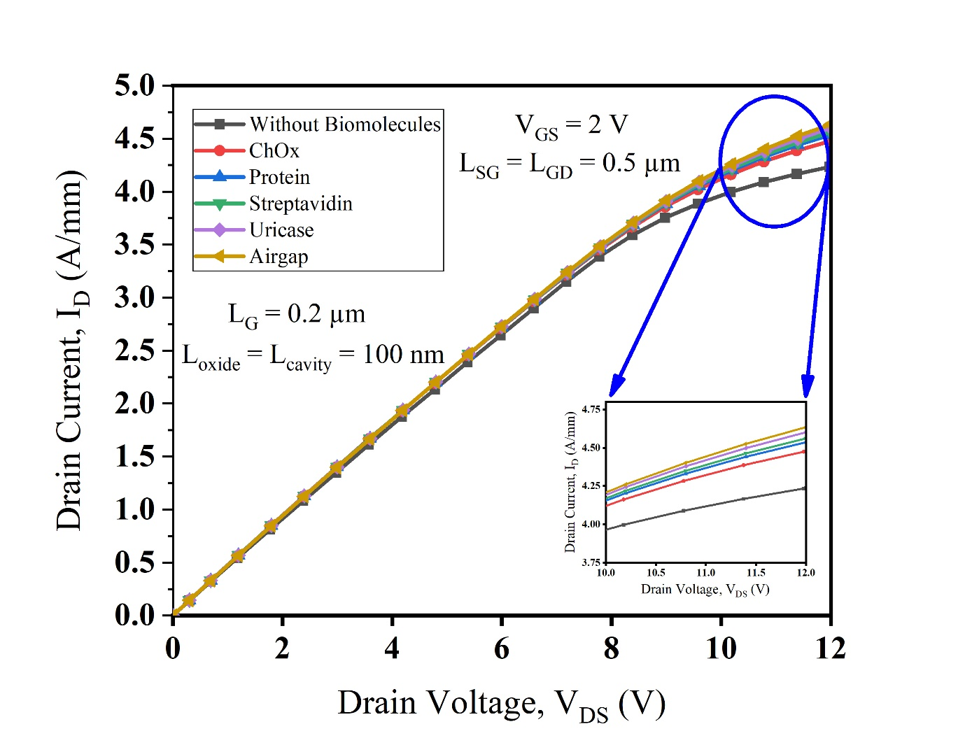
Output characteristics with V_{DS} in DM MOSHEMT device for various biomolecules
Inverse Relationship of Permittivity & Drain Current – Higher drain current (IDSI_{DS}) is observed for biomolecules with lower permittivity, following the inverse relationship between permittivity and drain current.
Variation in IDSI_{DS} for Biomolecules – Uricase (k=1.5k = 1.5) exhibits the highest IDSI_{DS} of 4.602 A/mm, while ChOx (k=3.5k = 3.5) shows the lowest IDSI_{DS} of 4.478 A/mm.
Impact of DMG Devices – DMG devices show higher IDSI_{DS} deviations due to gate shielding at the drain end, enhancing carrier transport efficiency and mitigating short-channel effects (SCEs).
Fig.1;Output characteristics with V_{DS} in DM MOSHEMT device for various biomolecules

Slide 13
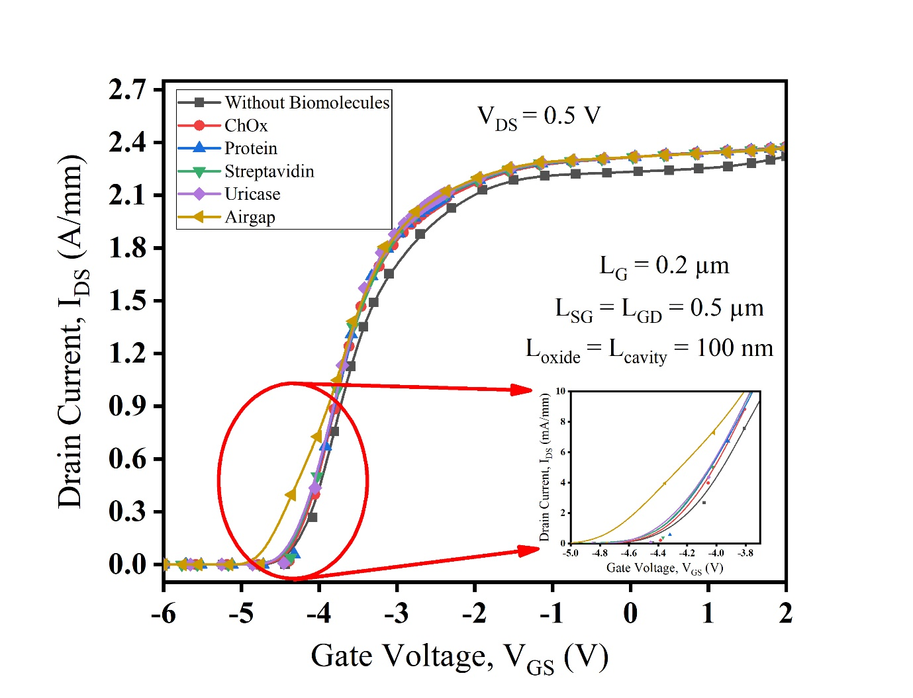
Transfer characteristics for fixed drain bias V_{DS} = 0.5 V in DMG device for different biomolecules.
Variation in Drain Current & Threshold Voltage – The presence of biomolecules in the cavity region causes significant changes in drain current and a proportional shift in threshold voltage (VthV_{th}).
Comparison of ChOx & Uricase – ChOx results in a more positive VthV_{th} compared to Uricase, while Uricase exhibits the highest drain current, and ChOx the lowest.
DMG vs. SMG Performance – DMG devices provide a higher drain current than SMG devices, highlighting their superior performance.
Fig.2; Transfer characteristics for fixed drain bias V_{DS} = 0.5 V in DMG device for different biomolecules.

Slide 14
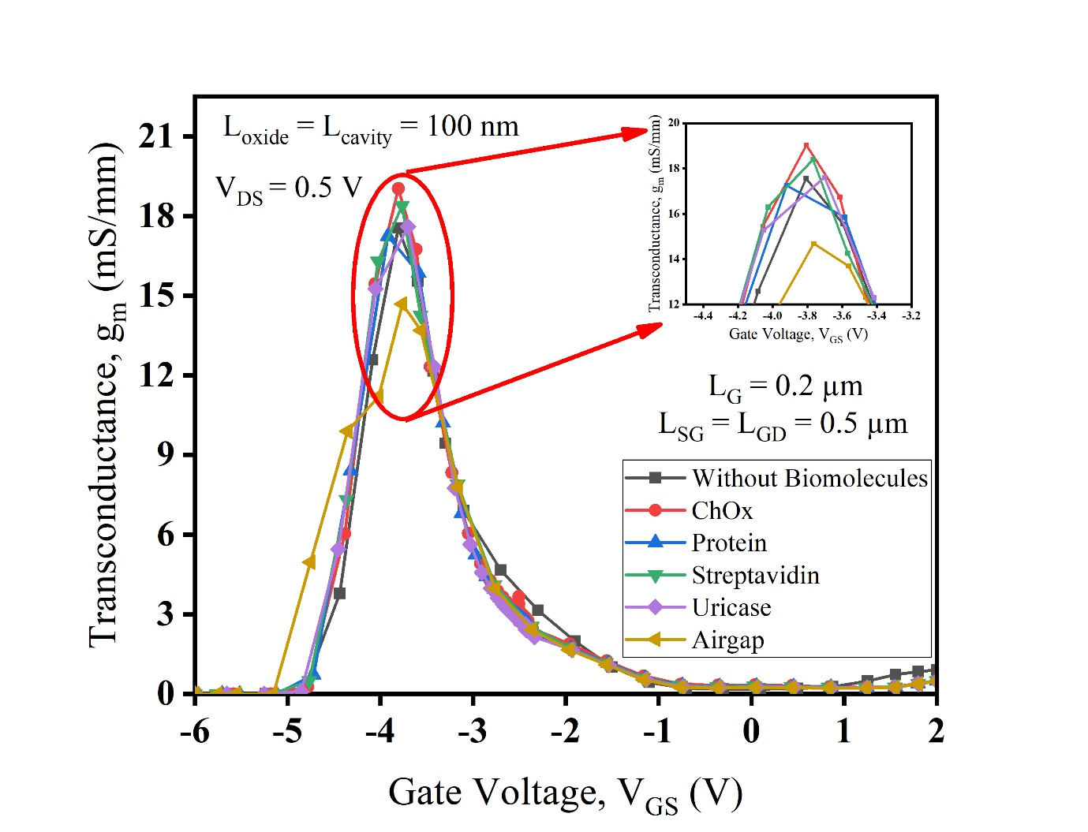
Transconductance characteristics plot with respect to V_{GS} in DMG devices at V_{DS} of 0.5 V for different biomolecules.
Transconductance Extraction – The transconductance (gmg_m) is derived from the first-order derivative of transfer characteristics (IDI_D-VGV_G) in AlGaN/GaN MOSHEMTs with an InGaN back-barrier, ensuring better gate control.
Comparison of gmg_m for Biomolecules – Among biomolecules (k=1.5k = 1.5 to 3.53.5), ChOx (k=3.5k = 3.5) exhibits the highest gmg_m (~19.5 mS/mm), while Al₂O₃ (k=9k = 9) shows the lowest (17.817.8 mS/mm).
Effect of InGaN Back-Barrier & DMG Technology – The InGaN back-barrier and DMG technology enhance carrier concentration in the potential well, leading to improved transconductance.
Fig 3; Transconductance characteristics plot with respect to V_{GS} in DMG devices at V_{DS} of 0.5 V for different biomolecules.

Slide 15
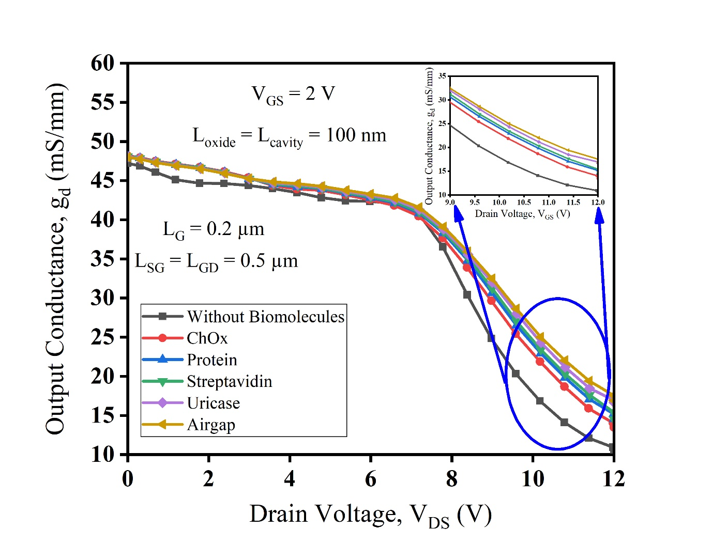
Output Conductance plot as a function of drain bias V_{DS} in DMG devices at V_{GS} of 2 V for different biomolecules.
Output Conductance & Sensitivity – Output conductance (gdg_d) is a key parameter for determining device sensitivity, and it decreases as permittivity increases, leading to reduced drain current.
Variation in gdg_d with Permittivity – gdg_d is highest (~19.5 mS/mm) for low-permittivity biomolecules and lowest (~12.5 mS/mm) for high-permittivity biomolecules.
Impact of InGaN Back-Barrier & DMG – The InGaN back-barrier with DMG enhances gate control, reduces leakage, increases sensitivity, and ensures stable device operation by shielding drain voltage fluctuations.
Fig:4; Output Conductance plot as a function of drain bias V_{DS} in DMG devices at V_{GS} of 2 V for different biomolecules.

Slide 16
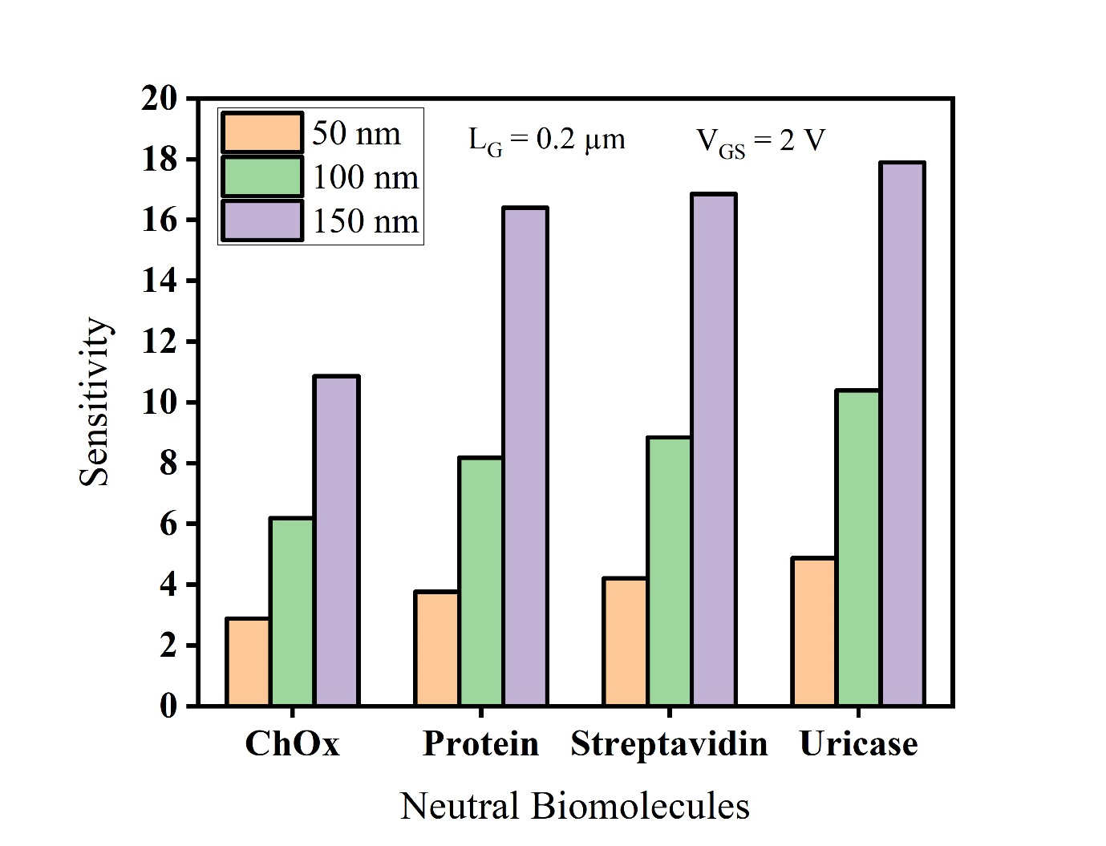
Drain-ON sensitivity of the DMG device with different biomolecules and different cavity lengths (50 nm, 100 nm, and 150 nm) at gate bias V_{GS} = 2 V.
Sensitivity Variation with Cavity Length – Drain-ON current sensitivity (SIONS_{ION}) increases with cavity length (50 nm to 150 nm), with Uricase showing the most significant change.
Effect of Larger Cavity – The maximum sensitivity is observed at 150 nm cavity length due to the larger surface area, enhancing biomolecule interaction with surface charges in the AlGaN layer.
Comparative Analysis – Tables provide insights into sensitivity variations across cavity lengths (Table II), drain current and threshold voltage trends for different permittivity values (Table III), and a comparison of drain current and sensitivity between SMG and DMG structures (Table IV).
Fig;5;Drain-ON sensitivity of the DMG device with different biomolecules and different cavity lengths (50 nm, 100 nm, and 150 nm) at gate bias V_{GS} = 2 V.

Slide 17
Use Cases & Testing
Use Cases
Disease Diagnostics:
Use: Biomarkers of diseases such as cancer, heart disease or infectious disease, such as COVID-19, in the body fluids: An example through which PSA can be detected for screening prostate cancer or DNA mutations in genetic disorders is through blood or saliva
Environmental Monitoring:
Use: Monitoring water quality by detecting the presence of pathogens like E. coli or toxins produced by harmful algal blooms. It can also be used for air quality control by detecting airborne viruses or pollutants.
Point-of-Care Testing (POCT):
Use: Using the biosensor in a handheld device for quick testing of blood glucose, cholesterol levels, or specific infections like HIV, without needing a full lab setup.
Food Safety and Quality Control:
Use: Identifying harmful bacteria such as Salmonella or Listeria in meat or dairy products, or detecting pesticide residues in fruits and vegetables.
Test Cases
Biomolecule Detection Sensitivity Test:
Objective: To measure the sensitivity of the biosensor to different biomolecules (both neutral and charged).
Threshold Voltage Shift Test:
Objective: To assess the accuracy of the sensor in detecting changes in threshold voltage caused by biomolecule introduction
Selectivity Test:
Objective: To evaluate the ability of the biosensor to differentiate between various types of biomolecules.
Geometrical Parameter Variation Test:
Objective: To test the impact of varying device parameters (AlGaN layer thickness, cavity height, etc.) on sensor performance.
Temperature Stability Test:
Objective: To ensure the sensor’s stability and performance across varying Temperature.

Slide 18
Implementation and Results – Iteration 1
Iteration 1 : Results
The initial stage of the project focused on the design and structural analysis of the GaN/AlN/HfAlOx MOS-HEMT biosensor. The design integrates a nanogap cavity below the gate to enhance biomolecule capture and detection efficiency. The biosensor’s architecture is composed of the critical layers.
The performance of the GaN/AlN/HfAlOx MOS-HEMT biosensor was assessed through simulations and experimental analyses, focusing on its sensitivity, electrical behavior, and biomolecule detection efficiency.
In the final stage, the GaN/AlN/HfAlOx MOS-HEMT biosensor design was optimized and validated through experimental and simulated evaluations. The focus was on maximizing the device's sensitivity, stability, and efficiency for biomolecule detection.
Key findings include:
Enhanced Sensitivity with Optimized AlGaN Thickness:
Impact of Nanogap Cavity Design on Detection Efficiency:

Slide 19
Implementation and Results – Iteration 2
Prototypes were validated against predefined use cases:
1). Low Viral Load Detection in Early-Stage Infection
Objective: Assess the ability of the MOSHEMT device to detect SARS virus particles at low concentrations, which are typical during the early stages of infection.
2). Selectivity in a Complex Biological Environment
Objective: Validate the sensor's ability to selectively detect SARS virus in the presence of other biomolecules and potential interferents.
3). Rapid Detection in Point-of-Care Settings
Objective: Evaluate the speed of detection and robustness of the MOSHEMT in a portable diagnostic context.
Validation Outcomes:
Case 1: Enabled accurate identification of genetic markers and early disease detection.
Case 2: Supported real-time monitoring of environmental contaminants for safety assurance.
Case 3: Enabled quick identification of contaminants, ensuring food safety compliance.

Slide 20
Conclusion & Future Work
Summary and Conclusion
It is discussed the GaN/AlN/AlGaN MOS-HEMT structure with the embedded cavity for biosensors. From the potential changes in dielectric modulation, threshold voltage and drain current shifts are exploited for detecting neutral and charged biomolecules. The electrostatic properties have been found to be modified by the simulations carried out in the tool ATLAS Silvaco. Therefore, it should be a potential biosensor for the DNA and proteins sensed with high sensitivity.
The cavity within the structure of the GaN/AlGaN HEMT, placed below the gate from the drain side, has been proved to be a biosensor. Biosensing both charged and neutral biomolecules becomes possible because of the electrical threshold voltage ΔVth and the change in drain current ΔIDS. When neutral species were sensed, the parameters ΔVth change from 305 mV to 1.12 V, ΔIDS from 35.1 to 153.7 mA/mm. While the DNA biomolecules are charged, ΔVth shifts up to 0.30 V and ΔIDS up to 65.2 mA/mm. The variation in the device parameters increases the sensitivity for biomedical applications.
Future Work
The proposed device also shows much potential in high-sensitivity applications, such as the detection of neutral and charged biomolecules. The future advancements may include material optimization, proper fabrication techniques of the device, extended applications beyond biosensing, and maybe integration into various wearable or point-of-care devices to meet the ever-growing demand for portable diagnostic tools in healthcare.

Slide 21
THANK YOU
Have a Great Day !

